Slide 1
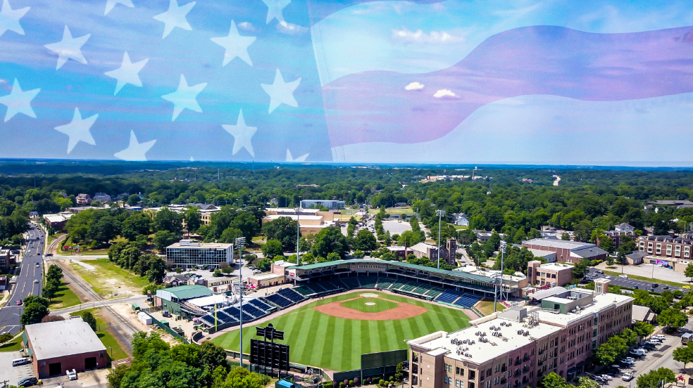

Upstate Salute @ Fluor Field – Benefitting The Upstate Veterans Alliance
Celebrating & Recognizing Our Community’s Military Heroes & First Responders
Event Overview & Sponsorship Opportunity
Event Date: November 8, 2026
Notes:
Read.

Slide 2





What is the Upstate Veterans Alliance?
The UVA Is A Nonprofit Organization Comprised Of Employees From GE Vernova, Prisma Health, Michelin & The Greenville Drive – Working Together To Recognize, Honor, And Support Local Veterans And Their Families
Notes:
Read.

Slide 3
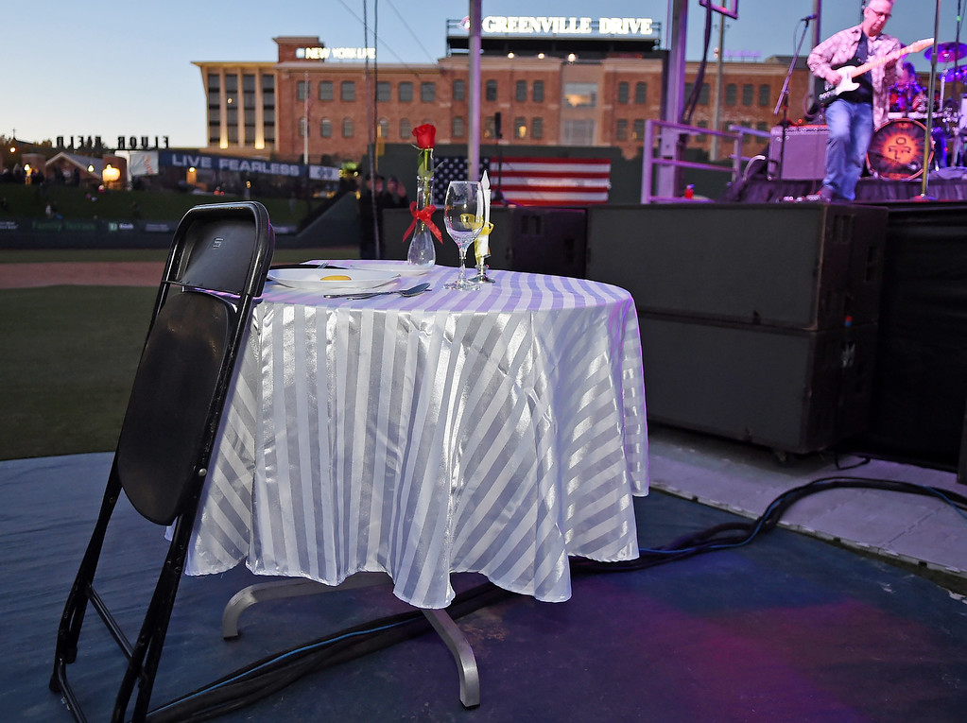
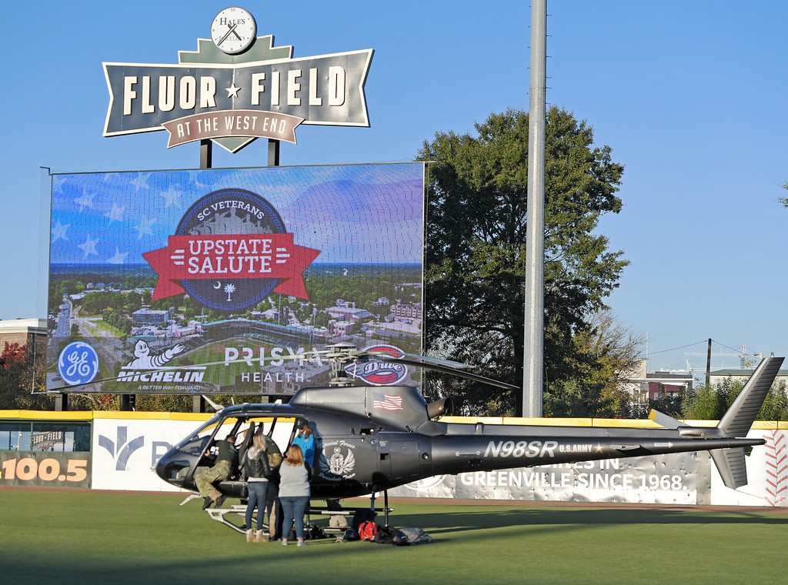
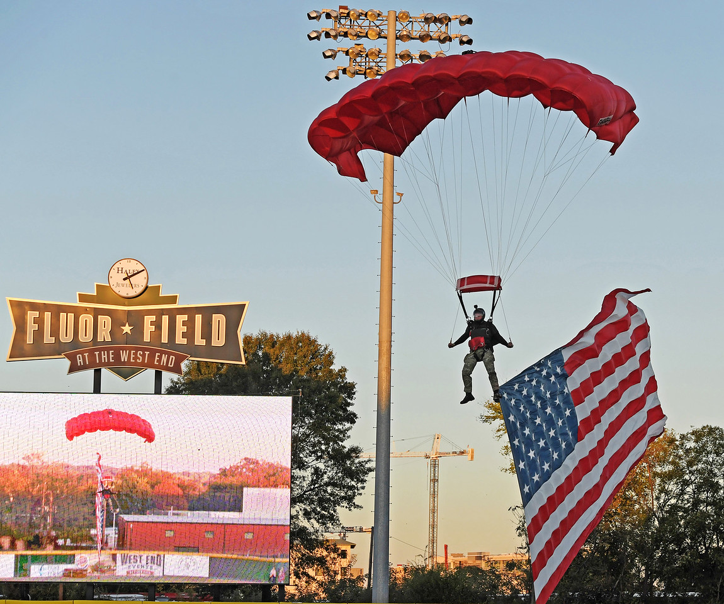
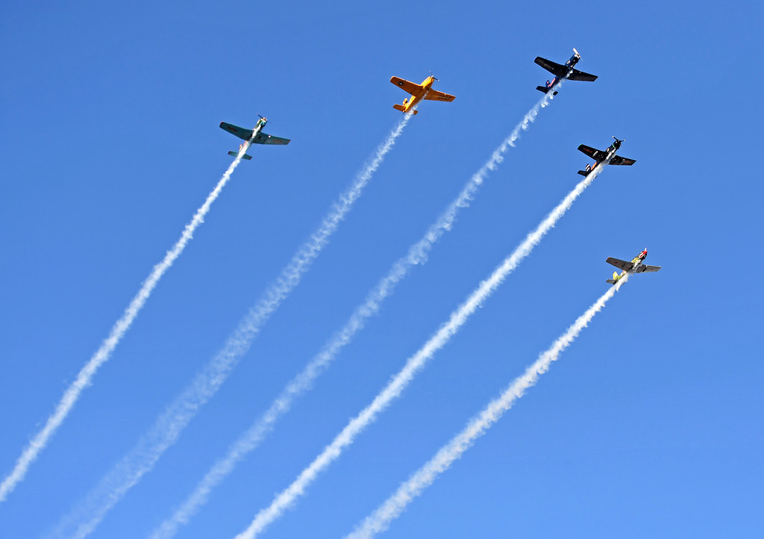
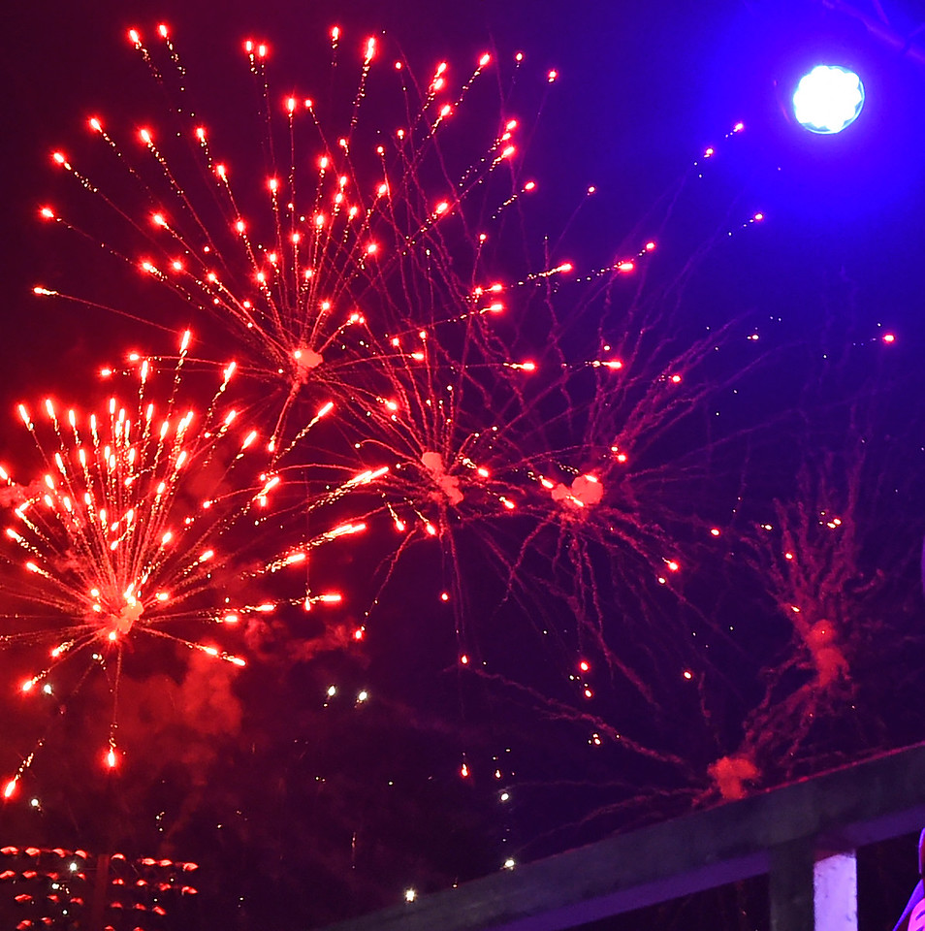
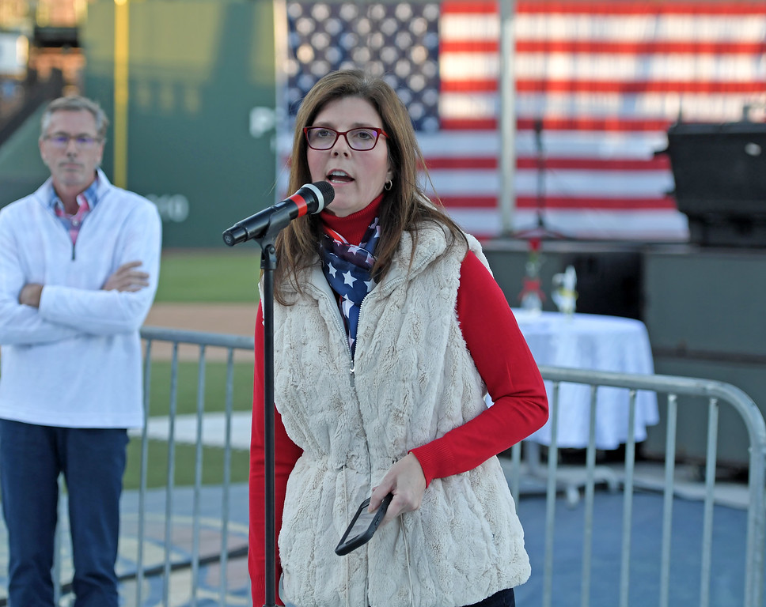
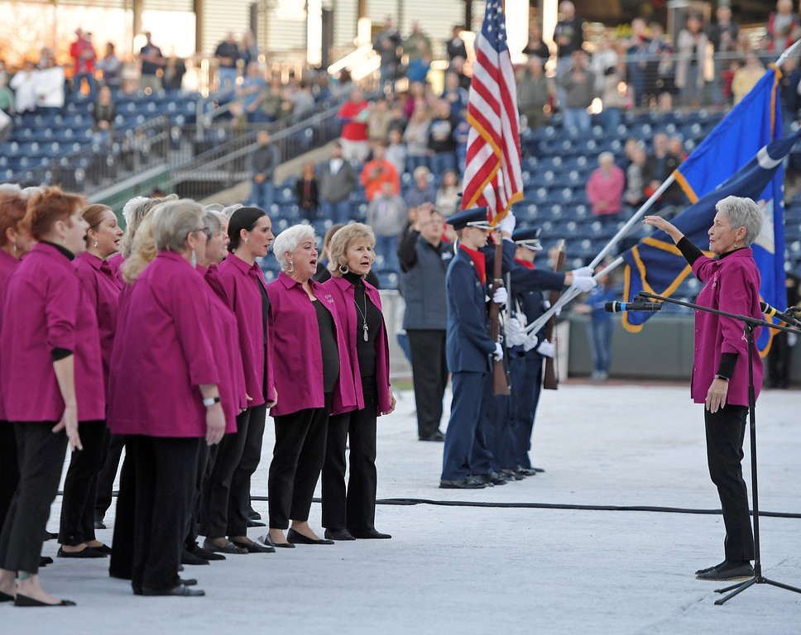
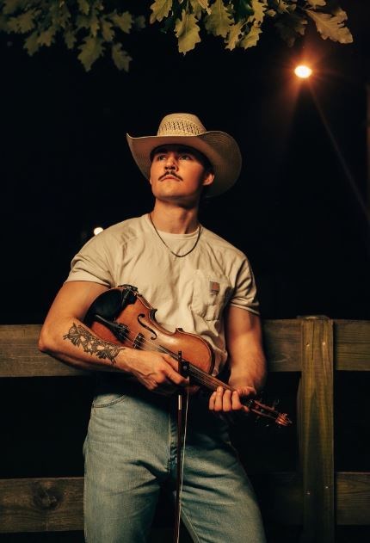
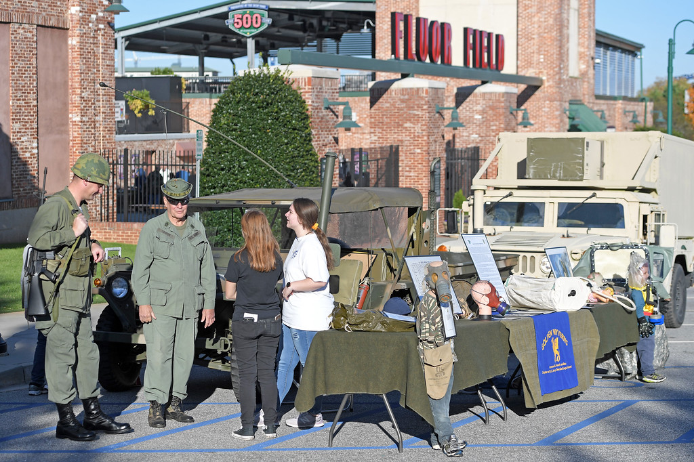
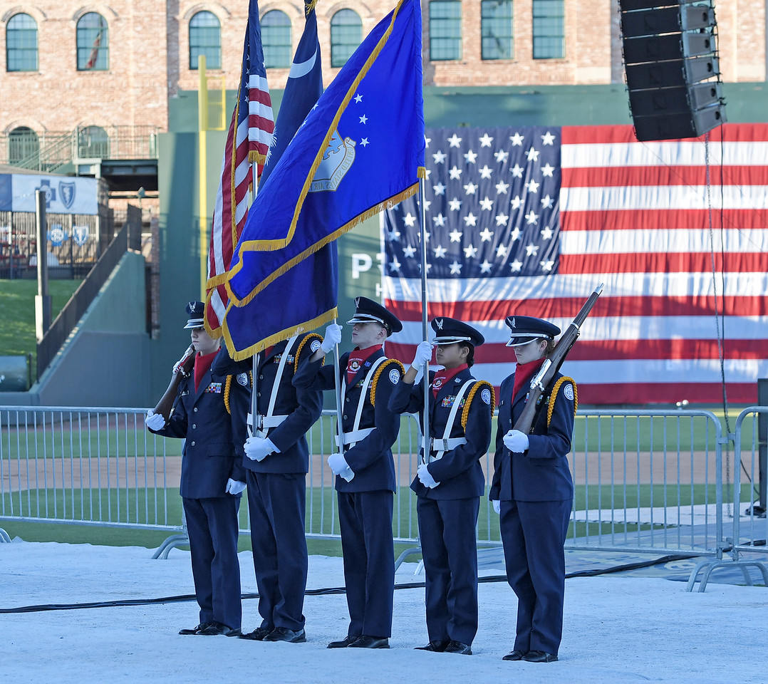
Upstate salute Overview
The Upstate’s premiere Veterans Day recognition & appreciation event at Downtown Fluor Field
Day-long, family friendly event featuring special military recognitions & performances, military vehicle displays, exhibits throughout the concourse from Veteran-focused organizations, and a live, on field concert
Complimentary event admission for all attendees; event proceeds benefitting the Upstate Veterans Alliance
Notes:
Read.

Slide 4

Upstate salute Artist Overview
Past Performers
Tracy Lawrence
Craig Morgan
Charlie Daniels
Filmore
Darryl Worley
Jefferson Starship
Colt Ford
Christian Stolz
Larry Fleet
2026 Performers
Dylan Marlowe, Colton Bowlin, & Ryan Spencer
Notes:
Read.

Slide 5
Opportunities To Participate & Support
Notes:
Read.

Slide 6

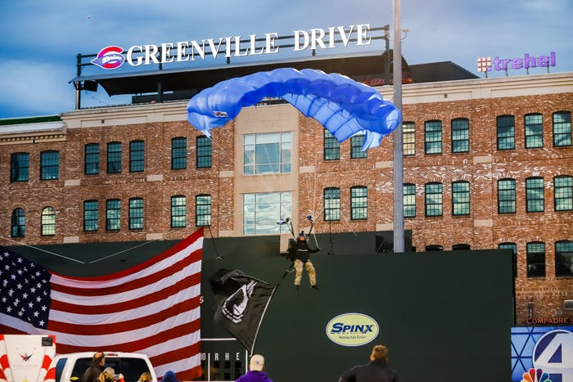


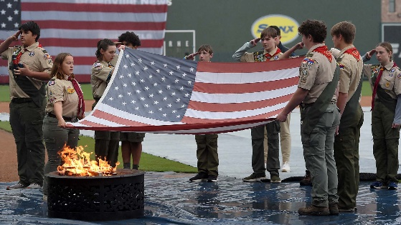
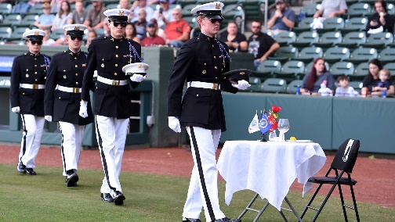
Event sponsorship: strategic overview
Holistic, Affordable Partnership Opportunities Available Providing Companies With Opportunities To Support The Community, The Military, And Your People
Proud Supporter of Our Community
Proud Supporter of The Military
Proud Supporter of Your Company/People
Notes:
Read.

Slide 7
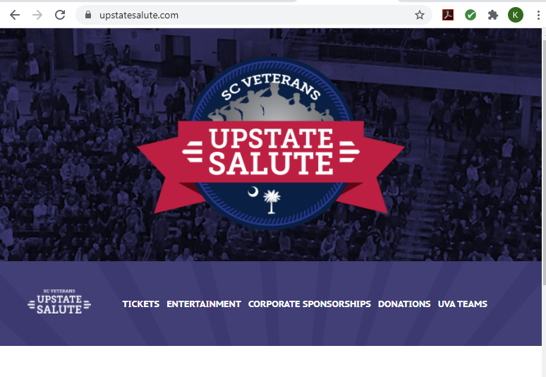
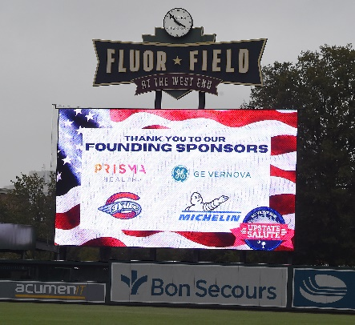
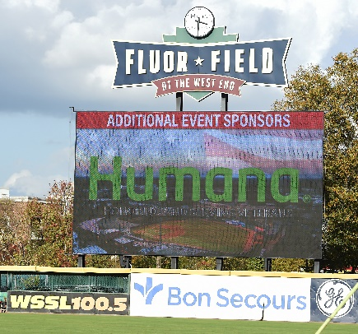
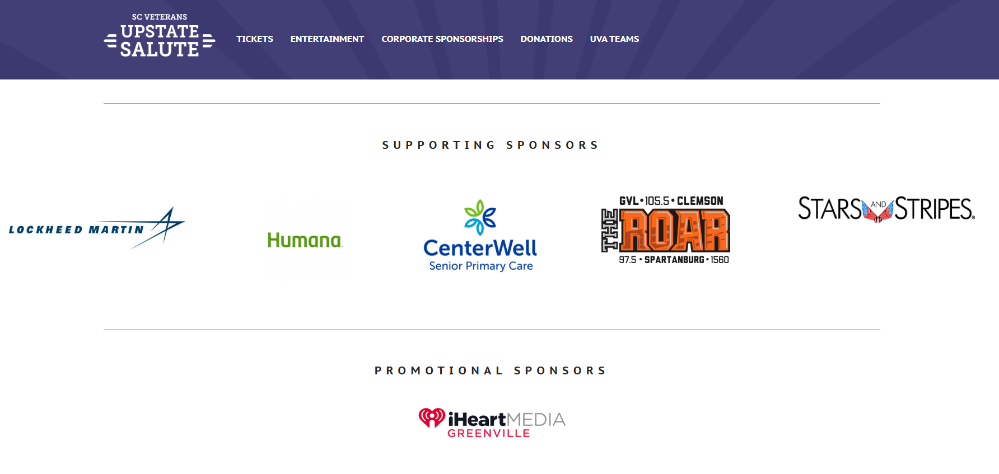
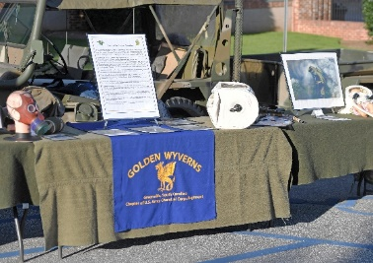
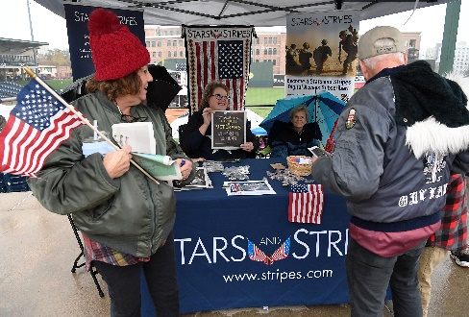
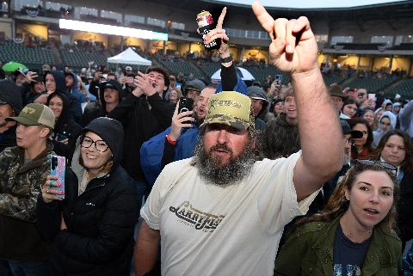
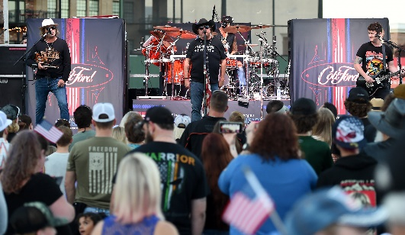
Event sponsorship: Elements available
Lead Up Marketing & Digital Visibility
During Event Stadium Visibility & Activation
100,000+ Total Media Impressions
5,000+ Annual Event Attendees
During Event Stadium Physical Presence
Event Access & Hospitality
5,000+ Annual Event Attendees
Wide Ranging Assets Available (Tickets, Hospitality, VIP, etc)
Notes:
Read.

Slide 8
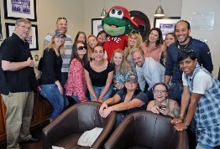
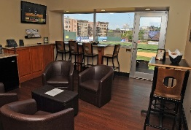
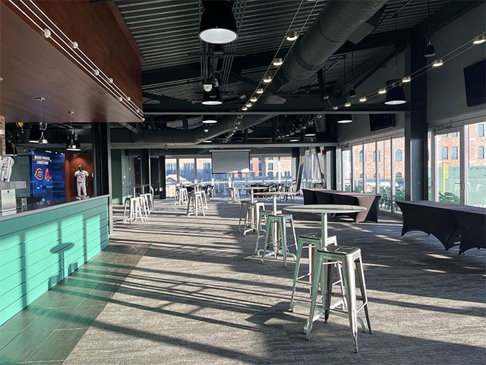
Event sponsorship: Packages available
$2,500 Investment
Event supporter visibility in Greenville Drive owned media channels (website, social media, e-blasts, marquee signs)
Event supporter visibility on UpstateSalute.com
During event visibility on the Drive Vision Video Board & Suite Façade Ribbon Board
During event visibility on Fluor Field’s in stadium digital ISM network
Up to 25 complimentary event tickets
$5,000 Investment
All elements above plus…
  (1) Fluor Field luxury suite for event entertainment & hospitality (24 person capacity; food & beverage expenses additional)
  Programming opportunity during the event itself (e.g., company check presentation, highlight/recognition of company veteran programs, etc.)
$7,500 Investment
All elements above plus…
  (4) passes to a catered VIP Reception in the AFL Champions Club
  Event supporter visibility in event paid media & advertising content
Notes:
Read.

Slide 9
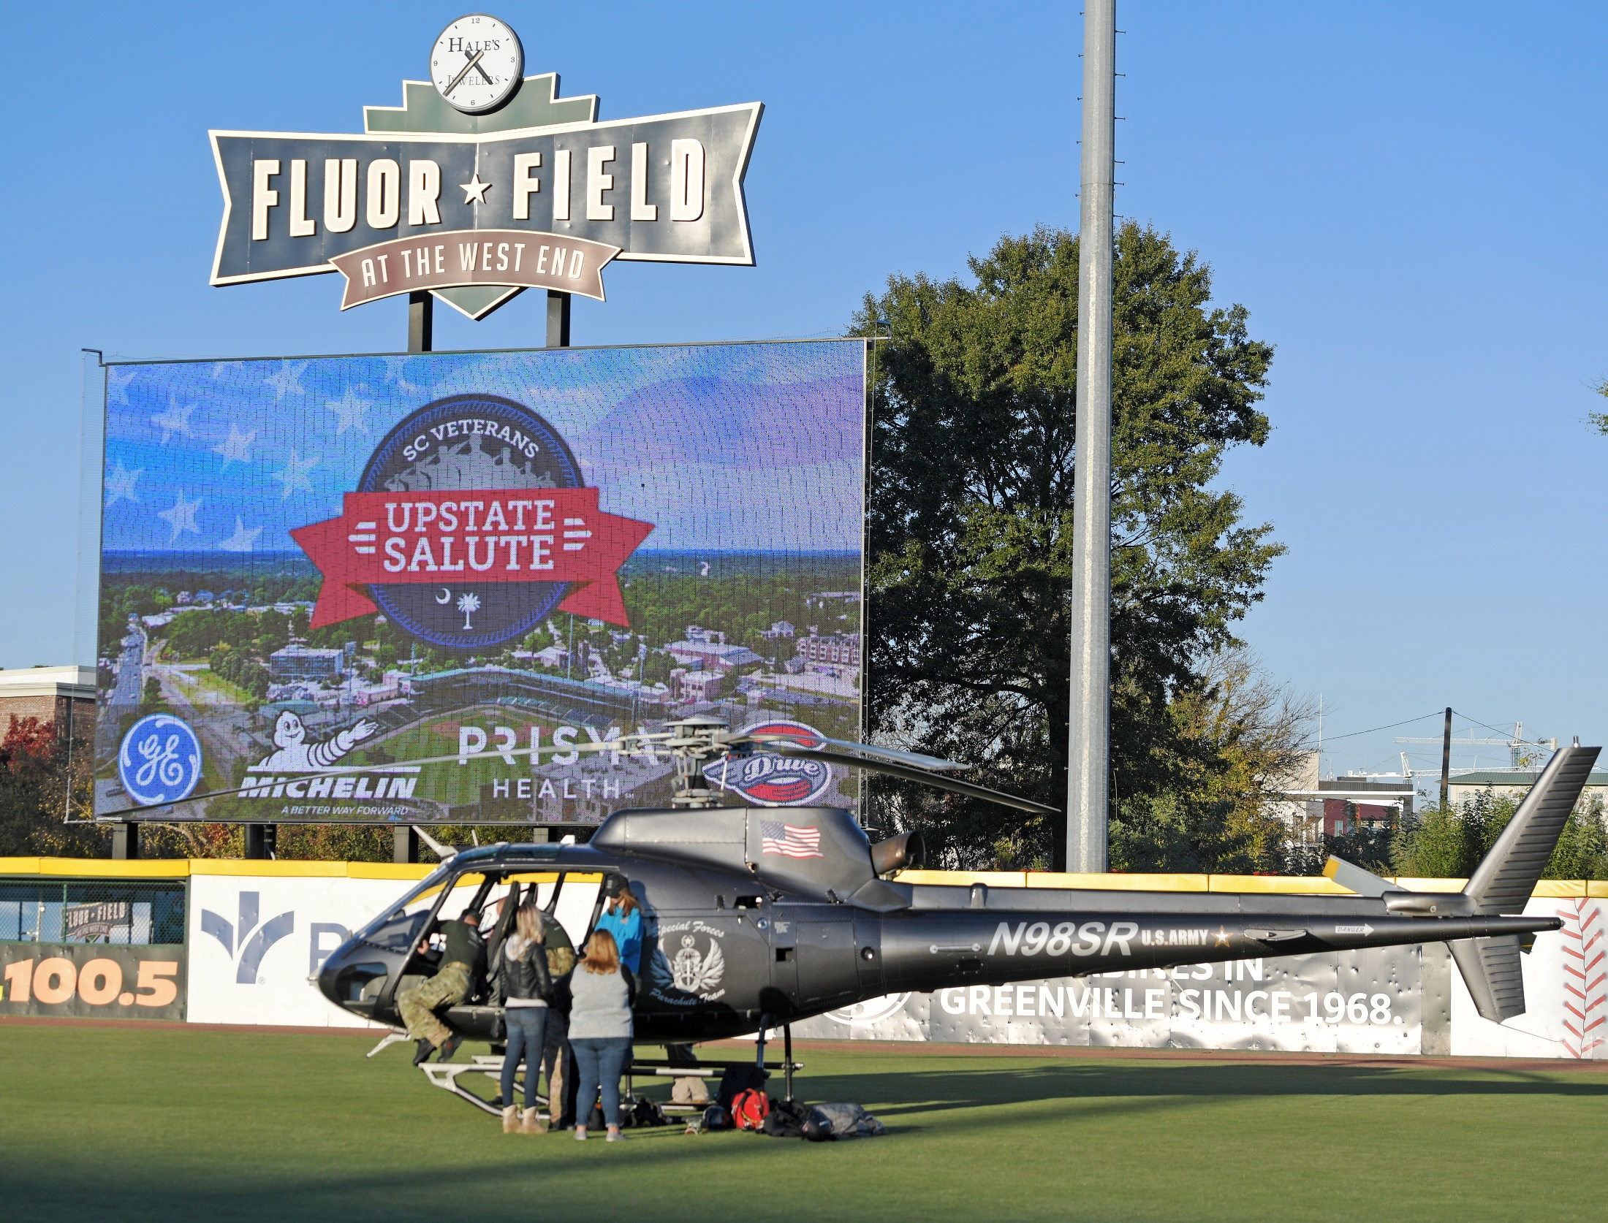
THANK YOU FOR YOUR TIME
For more information, please contact
Sara Carlton @ Sara.Carlton@greenvilledrive.com
Notes:
Read.

